Slide 1
Fredericton Municipal Elections 2021

Slide 2
Mayor Candidates

Slide 3
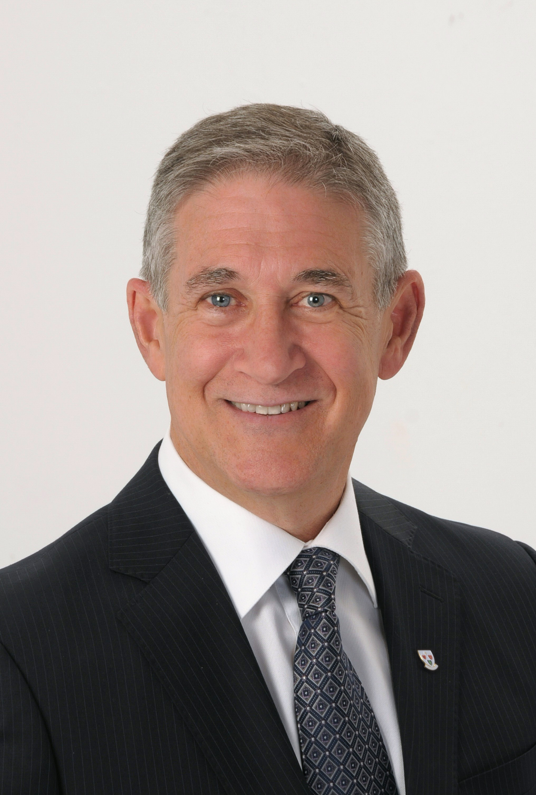
Mike O’Brien
WEBSITE https://www.mike4fredericton.com/?gclid=Cj0KCQjw4cOEBhDMARIsAA3XDRht7z2b8YlzvW--KnprHAyodmzJ_ZFvwlmBi06g6Gm1V2GKfgwov9UaApoiEALw_wcB
https://www.youtube.com/watch?v=vQaa6kSH97A

Slide 4
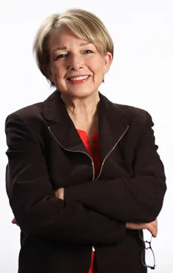
Corine Hersey
https://corinneforfrederictonmayor.com/ Website
https://www.youtube.com/watch?v=E7BczGP8L18 YouTube

Slide 5
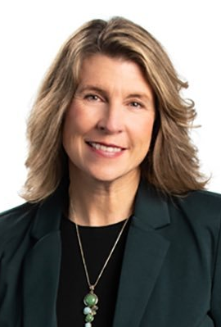
Kate Rogers
https://www.kateformayor.ca/ Website
https://www.youtube.com/watch?v=qEHFkBUWaDA YouTube Video

Slide 6
Drew Brown
YouTube????
Website????

Slide 7
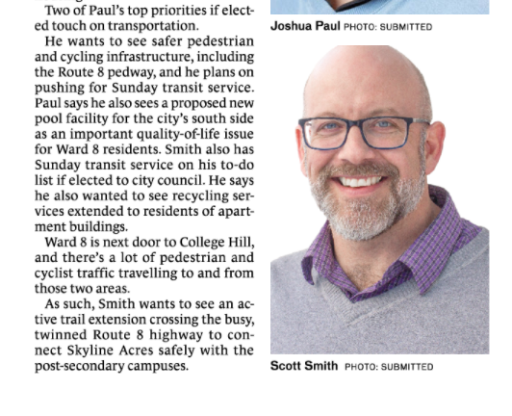
Skyline Acres – Ward 8 Candidates

Slide 8
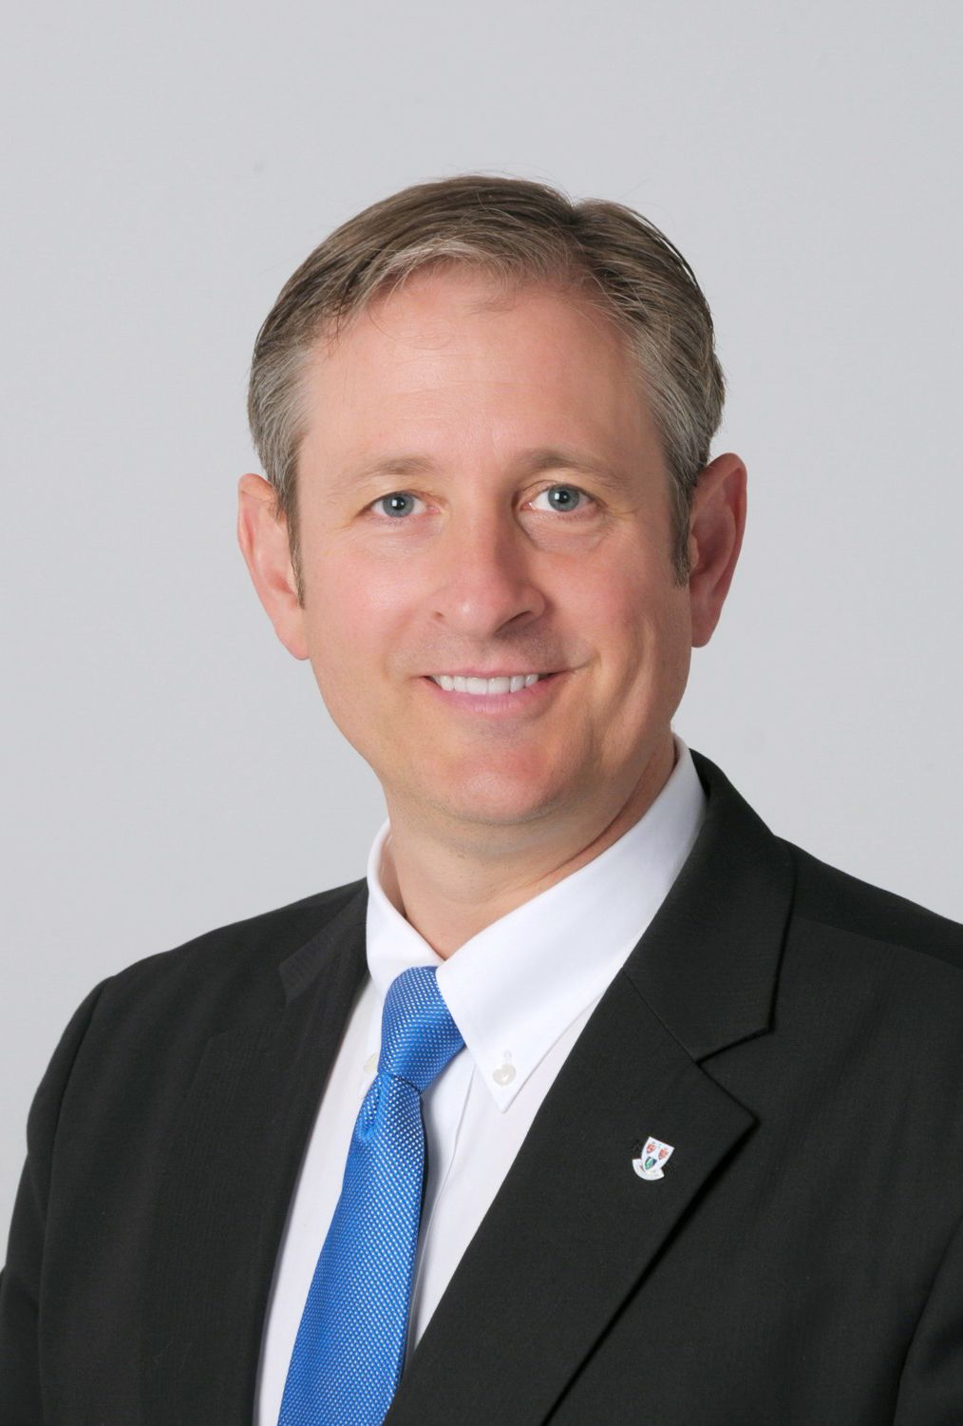
Gregory Ericson
(1) Greg Ericson - Posts | Facebook

Slide 9
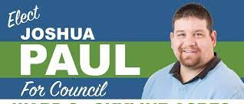
Joshua Paul

Slide 10
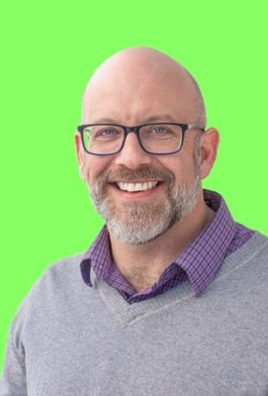
Scott Smith
https://www.facebook.com/scottsmithward8/

